Slide 1
EXPLORING GENERATIVE ADVERSARIAL NETWORKS
-Akash Gupta(30316010002)
-GaganDeep Singh(30316010018)
-Navonil Mukherjee(30316010024)

Slide 2


Slide 3
Table of Content:-
Introduction to GAN
Architecture of a GAN
Discriminator
Generator
Loss Function
Min Max
Implementation Details
Conclusion

Slide 4
What is Generative Adversarial Network?
Generative adversarial networks (GANs) are a class of artificial intelligence algorithms used in unsupervised machine learning, implemented by a system of two neural networks.
One network generates candidates (generative) and the other evaluates them (discriminative).
GANs have been used to produce samples of photorealistic images .

Slide 5
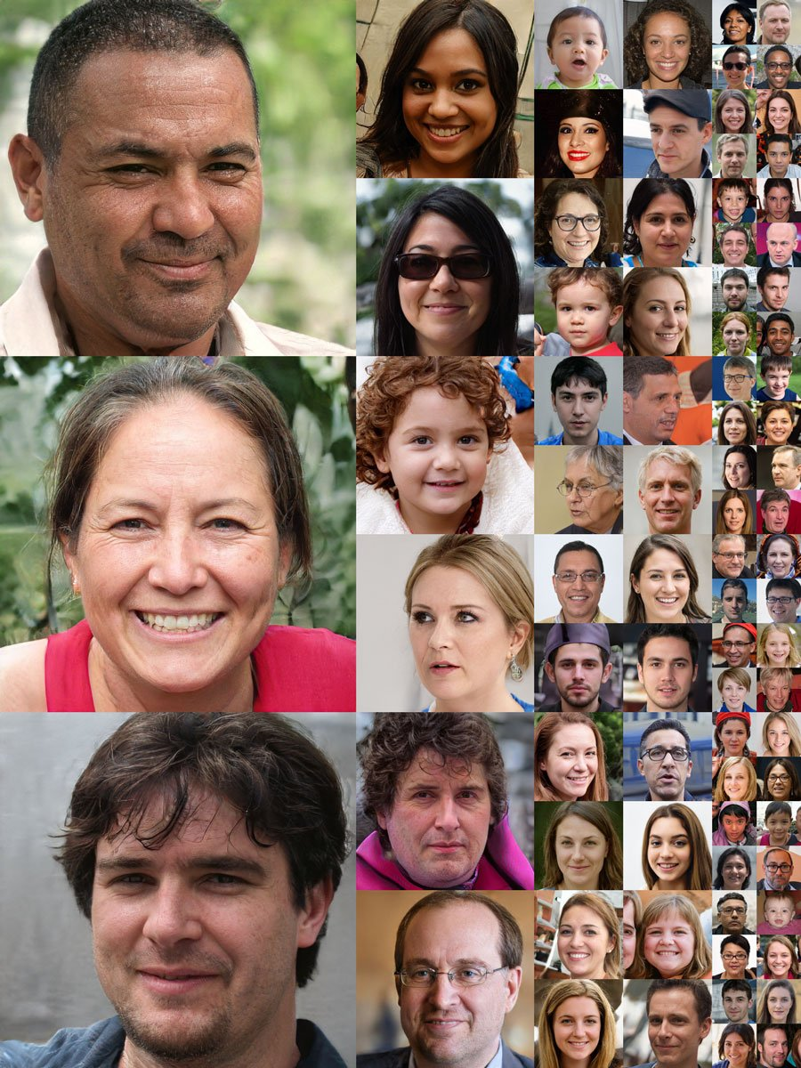
GANs in ACTION AT NVIDIA RESEARCH

Slide 6
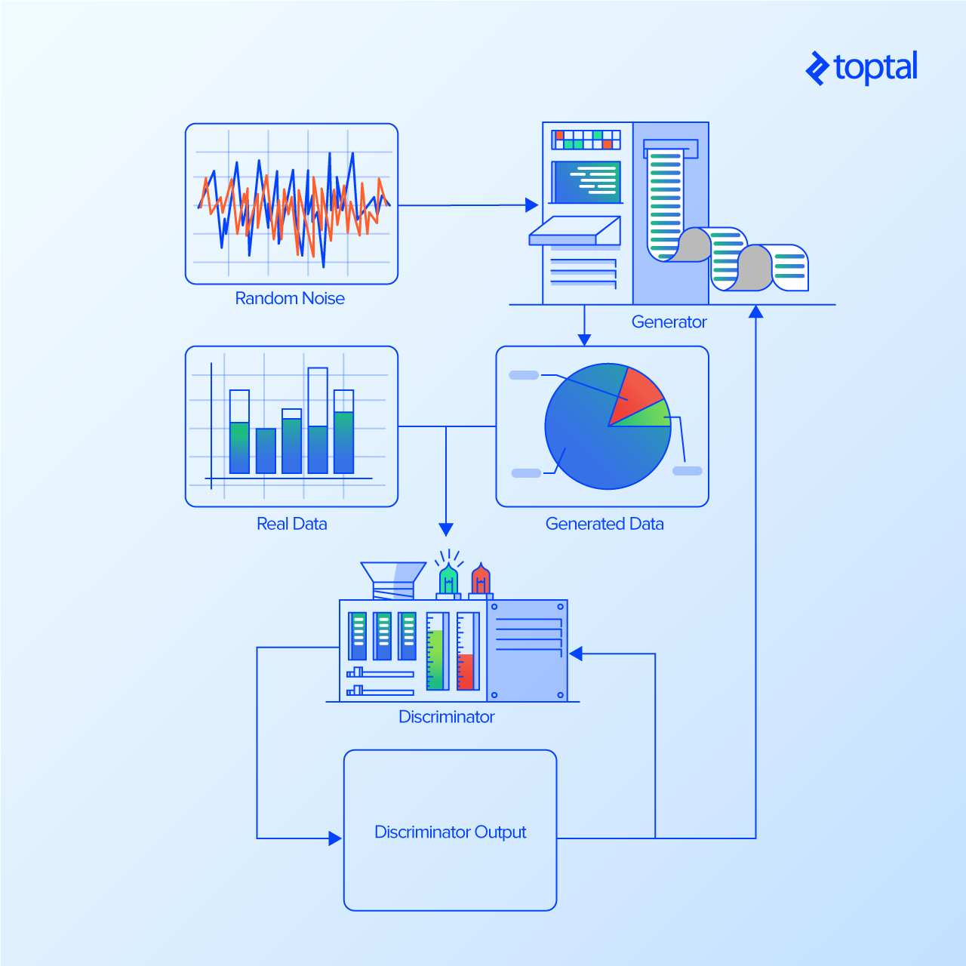
How GAN Works?

Slide 7
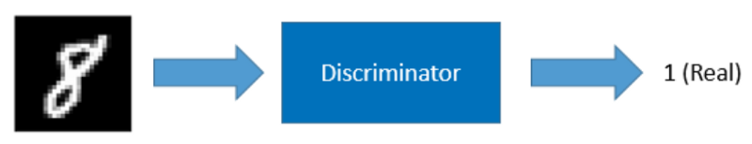
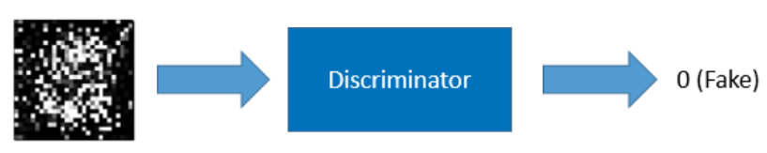
DISCRIMINATOR
The discriminator is a classifier trained using the supervised learning. It classifies whether an image is real (1) or not (0).
We train the discriminator using both the MNIST images and the images generated by the generator.
If the input image is from the MNIST database, the discriminator should classify it as real.
If the input image is from the generator, the discriminator should classify it as fake.

Slide 8

Cnn:-

Slide 9
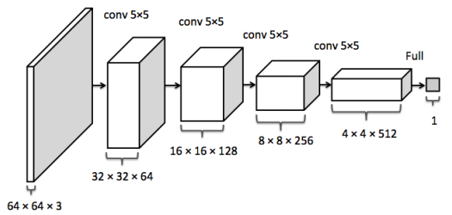
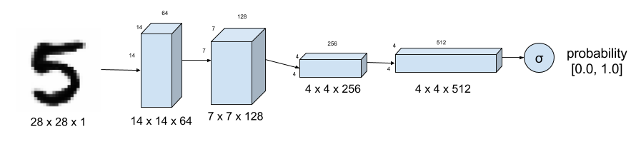
CONTD:-

Slide 10
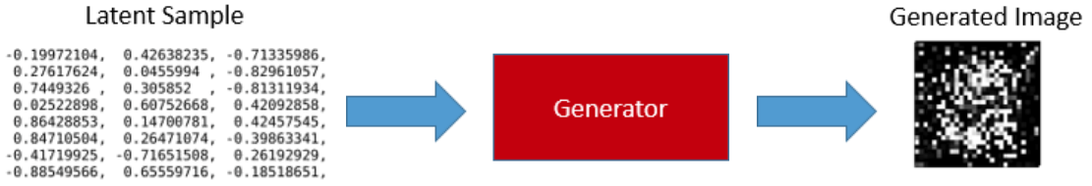
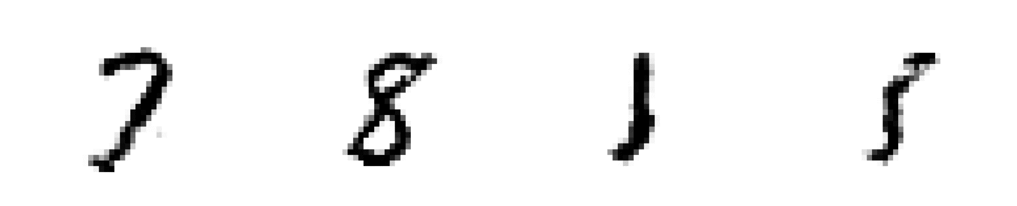
Generator
The input to the generator is a series of randomly generated numbers called latent sample. Once trained, the generator can produce digit images from latent samples.
Without training, the generator produces garbage images only.

Slide 11
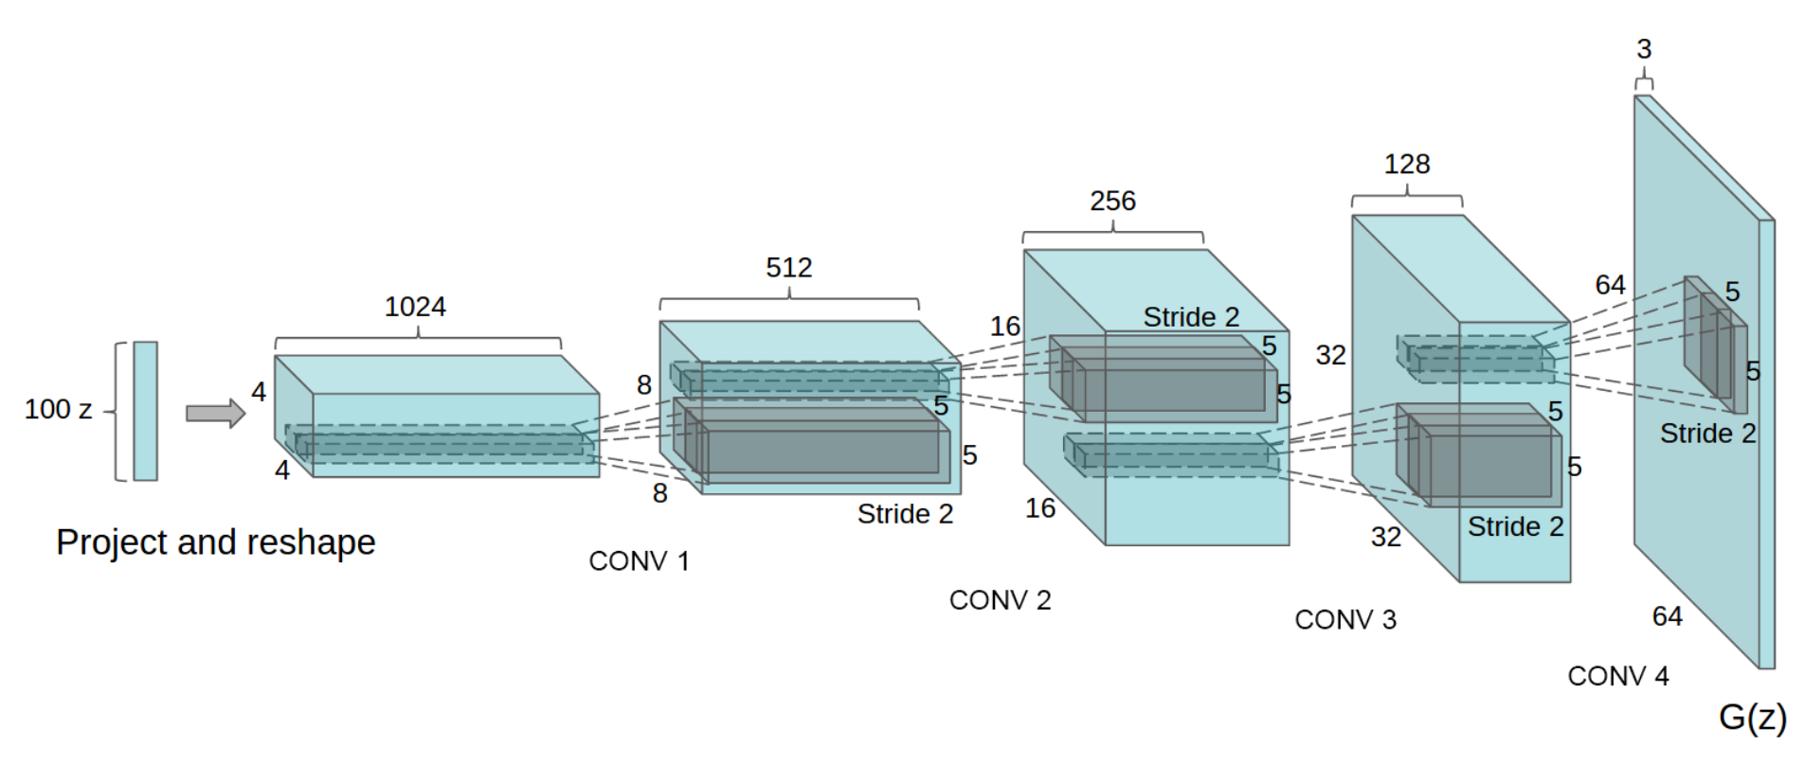
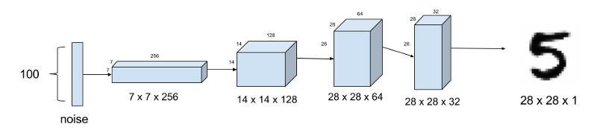
CONTD:-

Slide 12
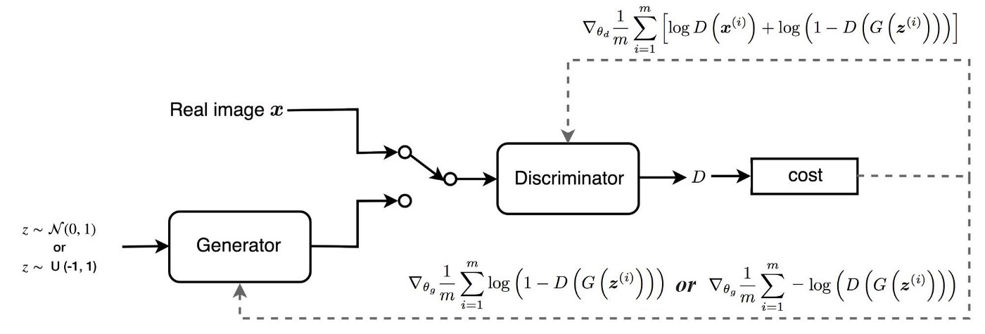
Loss Function:-
A loss function is a measure of how good a prediction model does in terms of being able to predict the expected outcome.

Slide 13
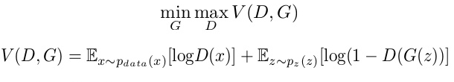
Mini-Max
In our function V(D, G) the first term is entropy that the data from real distribution (pdata(x)) passes through the discriminator (aka best case scenario). The discriminator tries to maximize this to 1. The second term is entropy that the data from random input (p(z)) passes through the generator, which then generates a fake sample which is then passed through the discriminator to identify the fakeness (aka worst case scenario). In this term, discriminator tries to maximize it to 0 (i.e. the log probability that the data from generated is fake is equal to 0). So overall, the discriminator is trying to maximize our function V.
On the other hand, the task of generator is exactly opposite, i.e. it tries to minimize the function V so that the differentiation between real and fake data is bare minimum.

Slide 14
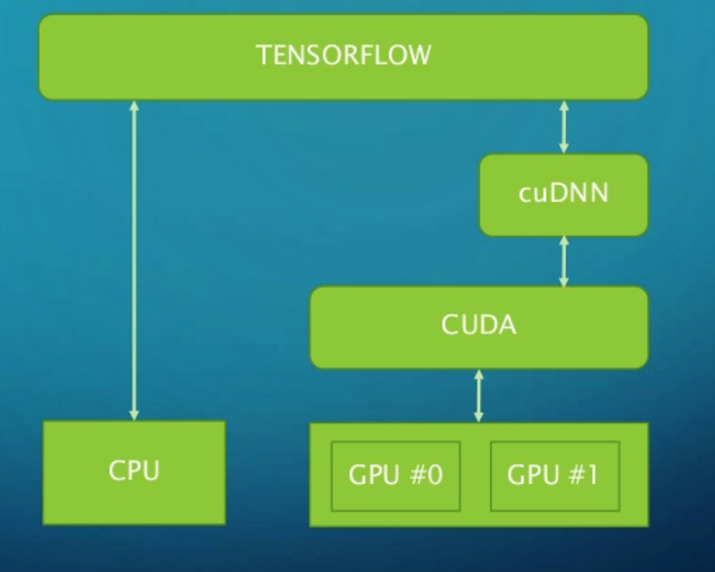
TensorFlow Platform Architecture

Slide 15
Getting started
We’re going to create a GAN that will generate handwritten digits that can fool even the best classifiers (and humans too, of course). We'll use TensorFlow, a deep learning library open-sourced by Google that makes it easy to train neural networks on GPUs. Steps to be followed are:-
Import the Data
Train the Discriminator
Train the Generator
Generate A Sample Image

Slide 16
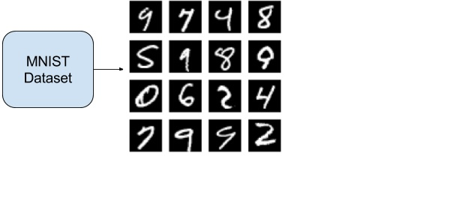
How Data is loaded
The images are initially formatted as a single row of 784 pixels. We can reshape them into 28 x 28 pixel images and view them using PyPlot.
We’ll use nextBatch method to create and retrieve a specified number of image from the sets.

Slide 17
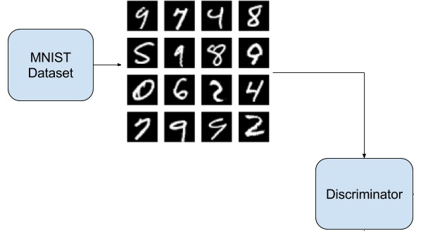
Training the discriminator
tf.nn.conv2d()-It takes 4 arguments The first is the input volume (our 28 x 28 x 1 images in this case). The next argument is the filter/weight matrix. Finally, you can also change the stride and padding of the convolution.

Slide 18
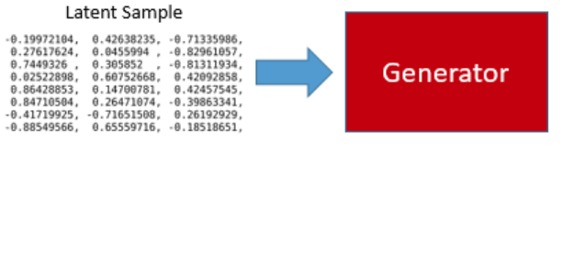
Training the Generator
tf.nn.conv2d_transpose() - It maps some random number of values into pixel.
tf.image.resize_images() - to resize the image.
tf.sigmoid() - to squeezes pixels.

Slide 19
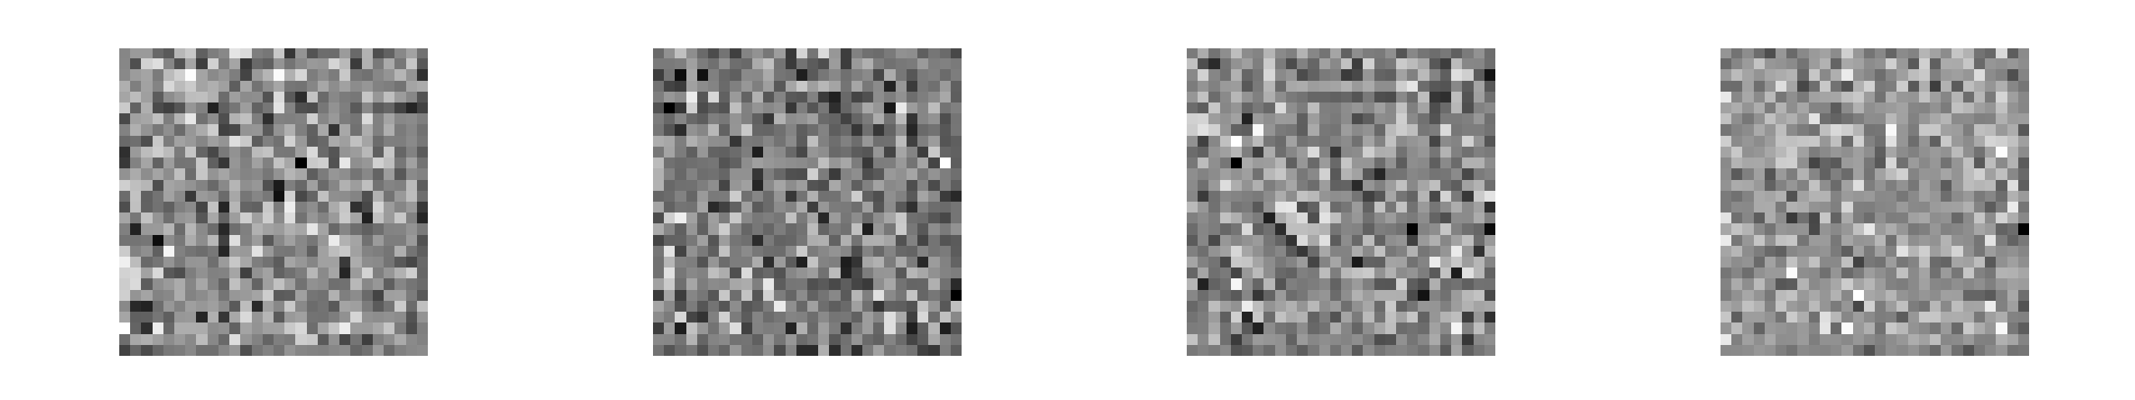
The GENERATOR IN ACTION

Slide 20
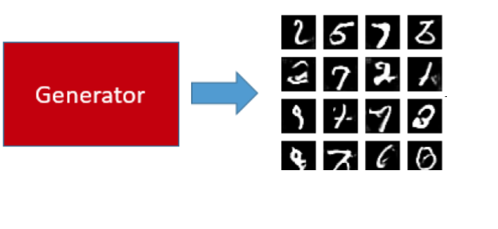
How generator creates image
We need to open a TensorFlow session sess.run() and create a placeholder for the input to our generator.
Now, we create a variable that holds the output of the generator, and we'll also initialize the random noise vector that we're going to use as input.
The np.random.normal() function has three arguments. The first and second define the mean and standard deviation for the normal distribution (0 and 1 in our case), and the third defines the the shape of the vector (1 x 100).

Slide 21
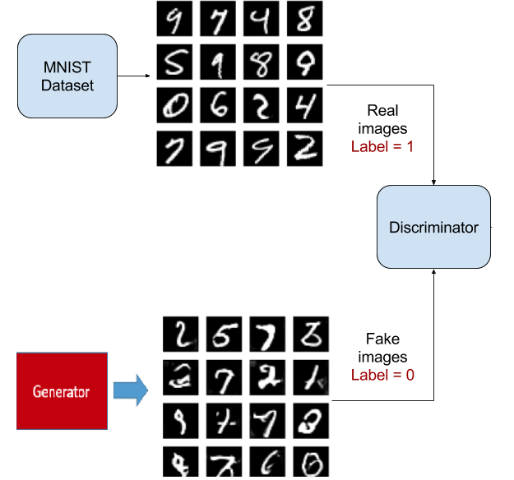
CONTD..
Discriminator uses the generated image and compares it

Slide 22
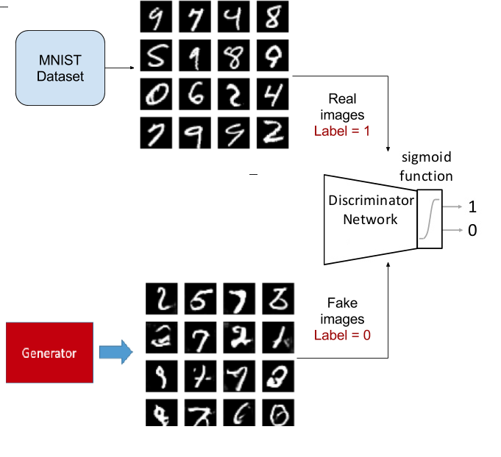
CONTD…
Discriminator labels fake and real images

Slide 23
Conclusion
Generative Adversarial Networks have quickly become an exciting sub-field of study finding applications in diverse fields. Their proven ability to mimic seemingly complex and arbitrary distributions make them an ideal candidate for creating samples where very large-scale data acquisition is difficult or infeasible. Companies like Google, Facebook, NVIDIA are all actively conducting research using GANs and they find applications in commercial software as 14 well. NVIDIA recently proposed a novel method for using style-transfer in their GAN for generating human faces and achieved startlingly realistic results. Ongoing research focuses on solving problems like mode collapse where generated samples stop being diverse because of the generator failing to learn to produce new features based on the training data.

Slide 24
Thank you

